Slide 1
ELECTRICTY PRICE
https://ember-energy.org/data/european-wholesale-electricity-price-data/

Slide 2
WtE Production Unit
Energy/technical data
 | Generating capacity for one unit [MW_e] | 8.12
 | Electrical efficiency (net, annual average) [] | 22%
 | Electrical efficiency (net, name plate) [] | 23%
 | Cb coefficient (40°C/80°C) | 0.29
 | Cv coefficient (40°C/80°C) | 1
 | Auxiliary Electricity consumption (share of heat gen.) [] | 3%
 | Forced outage [] | 1%
 | Planned outage [weeks per year] | 3.01
 | Technical lifetime [years] | 25
 | Construction time [years] | 2.5
 | Space requirement [1000 m2/MW_e] | 2.46
Regulation ability
 | Primary regulation (of full load, per 30 seconds) []
 | Secondary regulation (of full load, per minute) [] | 10%
 | Minimum load (of full load) [] | 20%
 | Warm start-up time [hours] | 0.5
 | Cold start-up time [hours] | 2
Environment
 | SO2 (degree of desulphuring) [] | 100%
 | NOX [g/GJ_i] | 40
 | CH4 [g/GJ_i] | 0.1
 | N2O [g/GJ_i] | 1
 | Particles [g/GJ_i] | 0.3
Financial data
 | Nominal investment (*total) [MEUR/MW_e] | 10.6
 | Nominal investment (equipment) [MEUR/MW_e] | 6.7
 | Nominal investment (installation) [MEUR/MW_e] | 3.9
 | Variable O&M (*total) [EUR/MWh_e] | 27.0
 | Fixed O&M (*total) [EUR/MW_e/y] | 406208.4
Technology-specific data
 | Heat efficiency (net, annual average) [] | 80%
 | Heat efficiency (net, name plate) [] | 79%
 | Nominal investment (*total) [MEUR/MW_i] | 2.4
 | Nominal investment (*total) [MEUR/t_i] | 903.9
 | Nominal investment (equipment) [MEUR/MW_i] | 1.6
 | Nominal investment (installation) [MEUR/MW_i] | 0.9
 | Variable O&M (*total) [EUR/MWh_i] | 6.3
 | Fixed O&M (*total) [EUR/MW_i/y] | 94214.8
 | Fixed O&M (*total) [EUR/t_i/y] | 34.7
 | Steam reheat | 0
 | Output of recovered condensate [t/MWh_i] | 0.11
 | Output of recovered condensate [EUR/t_i] | 18.4
 | Incineration capacity [t_i/h] | 11.88
 | Flue gas condensation | 1
 | Combustion air humidification | 0
 | Additional heat potential with heat pumps (of thermal input) [] | 4%
Parameter | Value
LHV | 10.6 MJ/kg
Waste handling price | 830 SEK/ton (0.830 SEK/kg) (Swedish waste Management 2023)
SEK → EUR average exchange rate (2023) | 1 SEK ≈ 0.08716 EUR (Exchange Rates)
Price in EUR/kg | 0.830 SEK/kg × 0.08716 ≈ 0.0723 EUR/kg
LHV in MWh/kg | 10.6 MJ/kg × 0.00027777778 MWh/MJ ≈ 0.00294 MWh/kg
Fuel cost per MWh (EUR) | 0.0723 EUR/kg ÷ 0.00294 MWh/kg ≈ 24.6 EUR/MWh

Slide 3
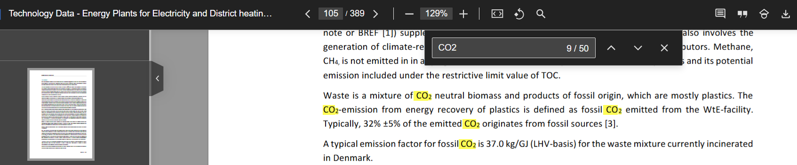
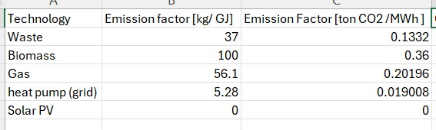
CO2 emission factor WtE = 37 kg/GJ

Slide 4
Wood Chips CHP Prod Unit
Energy/technical data
 | Generating capacity for one unit [MW_e] | 2.94
 | Electrical efficiency (net, annual average) [] | 14%
 | Electrical efficiency (net, name plate) [] | 15%
 | Cb coefficient (40°C/80°C) | 0.15
 | Cv coefficient (40°C/80°C) | 1
 | Auxiliary Electricity consumption (share of heat gen.) [] | 3%
 | Forced outage [] | 3%
 | Planned outage [weeks per year] | 3
 | Technical lifetime [years] | 25
 | Construction time [years] | 1
 | Space requirement [1000 m2/MW_e] | 0.68
Regulation ability
 | Primary regulation (of full load, per 30 seconds) []
 | Secondary regulation (of full load, per minute) [] | 10%
 | Minimum load (of full load) [] | 20%
 | Warm start-up time [hours] | 0.25
 | Cold start-up time [hours] | 0.5
Environment
 | SO2 (degree of desulphuring) [] | 98%
 | NOX [g/GJ_i] | 40
 | CH4 [g/GJ_i] | 8
 | N2O [g/GJ_i] | 1
 | Particles [g/GJ_i] | 0.3
Financial data
 | Nominal investment (*total) [MEUR/MW_e] | 6.37
 | Nominal investment (equipment) [MEUR/MW_e] | 3.96
 | Nominal investment (installation) [MEUR/MW_e] | 2.41
 | Variable O&M (*total) [EUR/MWh_e] | 9.80
 | Fixed O&M (*total) [EUR/MW_e/y] | 290300.75
Technology-specific data
 | Heat efficiency (net, annual average) [] | 97%
 | Heat efficiency (net, name plate) [] | 97%
 | Nominal investment (*total) [MEUR/MW_i] | 0.94
 | Nominal investment (equipment) [MEUR/MW_i] | 0.58
 | Nominal investment (installation) [MEUR/MW_i] | 0.35
 | Variable O&M (*total) [EUR/MWh_i] | 1.45
 | Fixed O&M (*total) [EUR/MW_i/y] | 42747.58
 | Fuel storage specific cost in excess of 2 days [MEUR/MW_i/storage day] | 0.02
 | Steam reheat | 0
 | Output of recovered condensate [t/MWh_i] | 0.25
 | Flue gas condensation | 1
 | Combustion air humidification | 1
 | Additional heat potential with heat pumps (of thermal input) [] | 2%
https://pxexternal.energimyndigheten.se/pxweb/en/Energimyndighetens_statistikdatabas/Energimyndighetens_statistikdatabas__Officiell_energistatistik__Tradbransle_och_torvpriser/5_EN0307_6.px/?utm_source=chatgpt.com

Slide 5
Natural Gas DH Only Prod Unit
Energy/technical data
 | Generating capacity for one unit [MW_h] | 0.5
 | Heat efficiency (net, annual average) [] | 93%
 | Heat efficiency (net, name plate) [] | 95%
 | Auxiliary Electricity consumption (share of heat gen.) [] | 0%
 | Forced outage [] | 0%
 | Planned outage [weeks per year] | 0.3
 | Technical lifetime [years] | 25
 | Construction time [years] | 0.2
 | Space requirement [1000 m2/MW_h] | 0
Regulation ability
 | Primary regulation (of full load, per 30 seconds) []
 | Secondary regulation (of full load, per minute) []
 | Minimum load (of full load) [] | 10%
 | Warm start-up time [hours] | 0.08
 | Cold start-up time [hours] | 0.3
Environment
 | SO2 [g/GJ_i] | 0
 | NOX [g/GJ_i] | 8
 | CH4 [g/GJ_i] | 2
 | N2O [g/GJ_i]
Financial data
 | Nominal investment (*total) [MEUR/MW_h] | 0.04
 | Nominal investment (equipment) [MEUR/MW_h] | 0.03
 | Nominal investment (installation) [MEUR/MW_h] | 0.01
 | Variable O&M (*total) [EUR/MWh_h] | 0.64
 | Variable O&M (electricity cost) [EUR/MWh_h] | 0.11
 | Variable O&M (other O&M) [EUR/MWh_h] | 0.53
 | Fixed O&M (*total) [EUR/MW_h/y] | 1063.37
https://www.investing.com/commodities/dutch-ttf-gas-c1-futures

Slide 6
Heat Pump Excess Heat
Energy/technical data
 | Generating capacity for one unit [MW_h] | 1
 | Heat efficiency (net, annual average) [] | 430%
 | Heat efficiency (net, name plate) [] | 420%
 | Auxiliary Electricity consumption (share of heat gen.) [] | 1%
 | Forced outage [] | 0%
 | Planned outage [weeks per year] | 1
 | Technical lifetime [years] | 25
 | Construction time [years] | 0.5
 | Space requirement [1000 m2/MW_h] | 0.1
Regulation ability
 | Primary regulation (of full load, per 30 seconds) [] | 5%
 | Secondary regulation (of full load, per minute) [] | 10%
 | Minimum load (of full load) [] | 25%
 | Warm start-up time [hours] | 0.1
 | Cold start-up time [hours] | 1
Environment
 | SO2 (degree of desulphuring) []
 | NOX [g/GJ_i]
 | CH4 [g/GJ_i]
 | N2O [g/GJ_i]
 | Particles [g/GJ_i]
Financial data
 | Nominal investment (*total) [MEUR/MW_h] | 1.21
 | Nominal investment (equipment) [MEUR/MW_h] | 0.91
 | Nominal investment (grid connection) [MEUR/MW_e] | 0.02
 | Nominal investment (installation) [MEUR/MW_h] | 0.22
 | Variable O&M (*total) [EUR/MWh_h] | 2.86
 | Variable O&M (electricity cost) [EUR/MWh_h] | 0.00
 | Variable O&M (other O&M) [EUR/MWh_h] | 2.86
 | Fixed O&M (*total) [EUR/MW_h/y] | 2126.75
 | Startup cost [EUR/MW_h/startup] | 10.63
Technology-specific data

Slide 7
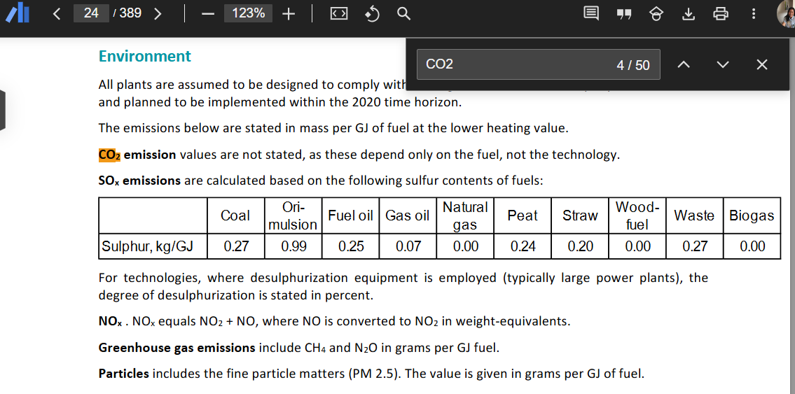
Carbon Emissions Data (2024)
https://www.investing.com/commodities/carbon-emissions-historical-data
https://tradingeconomics.com/commodity/carbon

